Slide 1

ACIDS, BASES AND SALTS
Introduction of acids, bases and Indicators

Slide 2
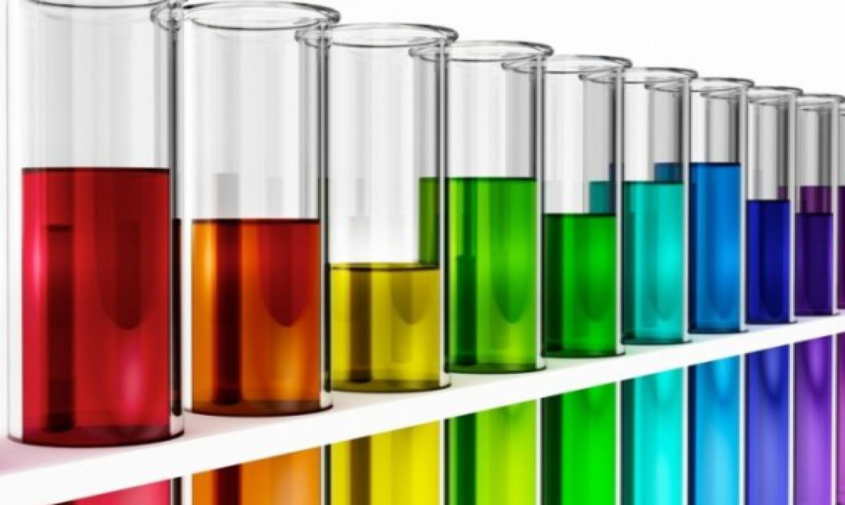
ACIDS, BASES AND SALTS

Slide 3
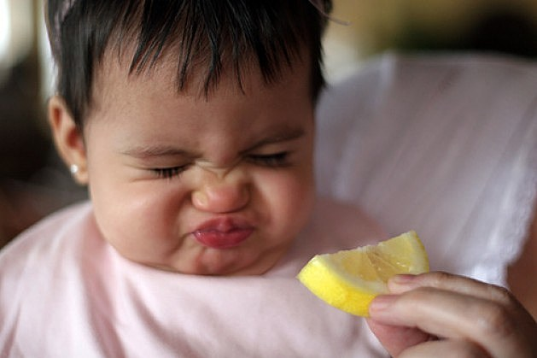
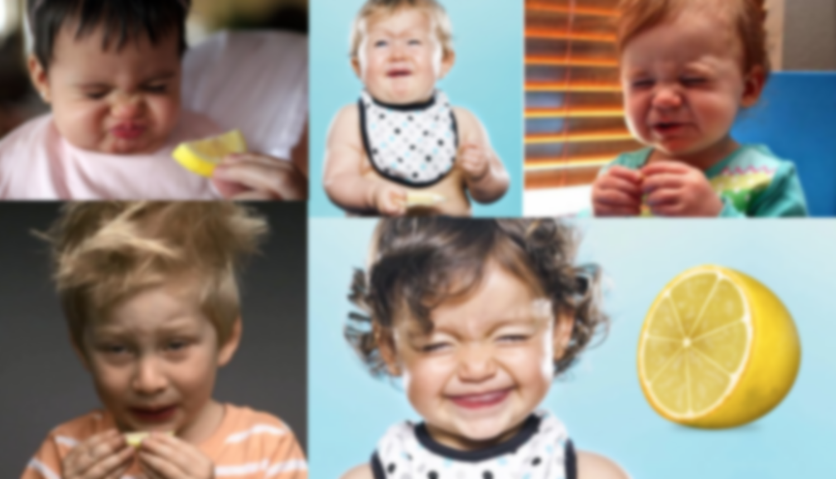
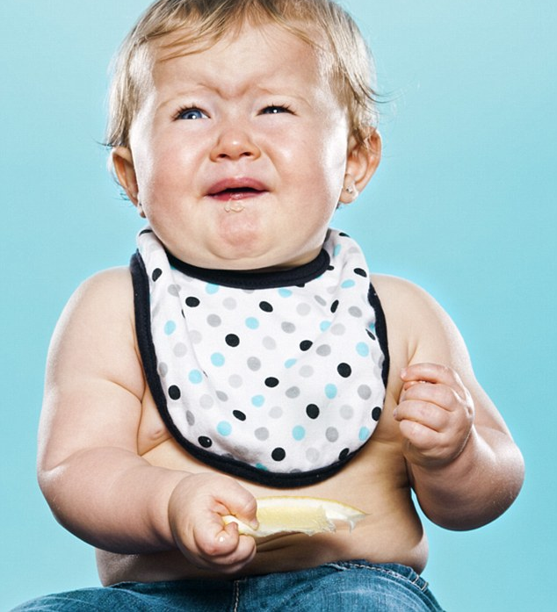
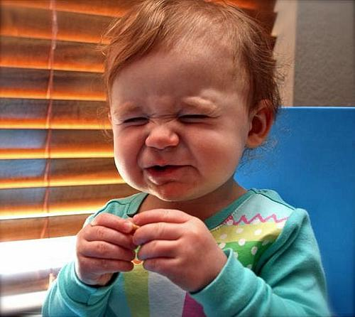
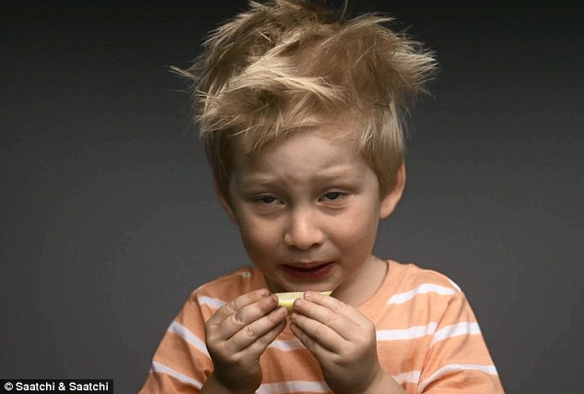
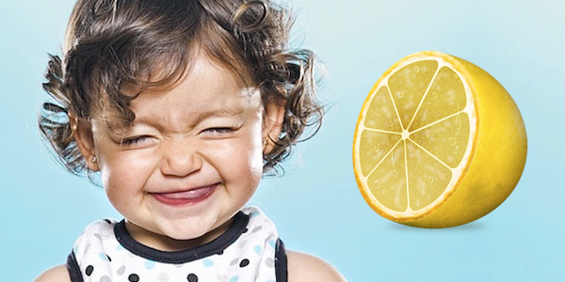
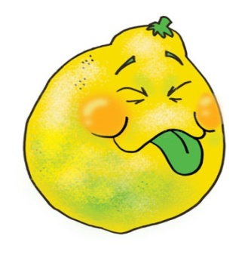
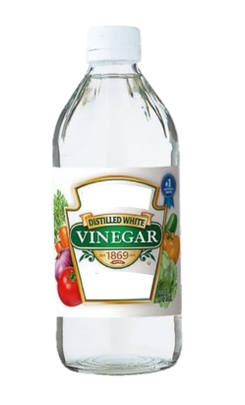



ACIDS
Substances which are sour to taste have acidic ingredients and their solutions are Acids.
C₆H₈O₇
CH₃COOH
C₄H₆O₆
C₂H₂O₄
Citric acid
Acetic acid
Tartaric acid
Oxalic acid
Lemon
Vinegar
Tamarind
Tomato

Slide 4
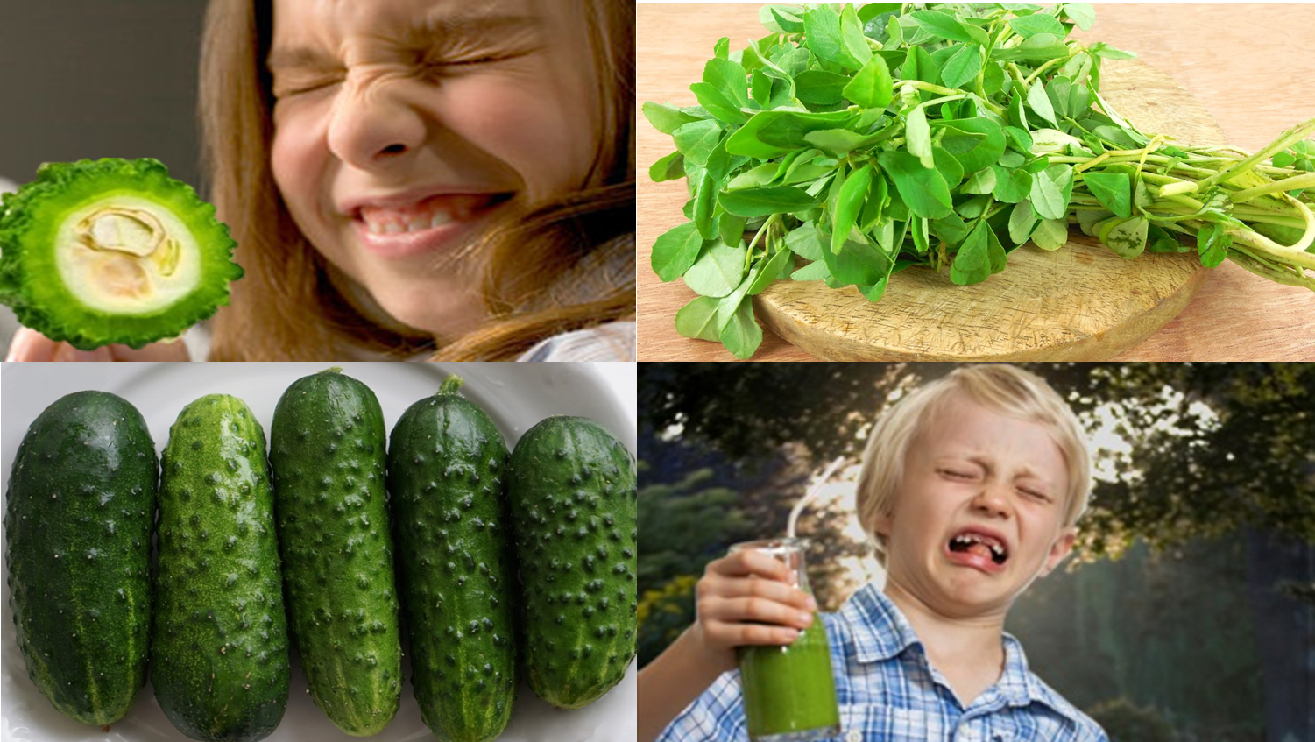
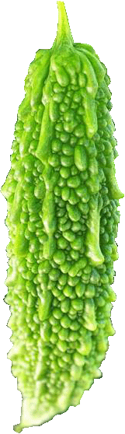
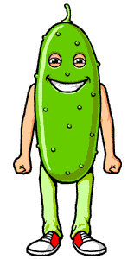
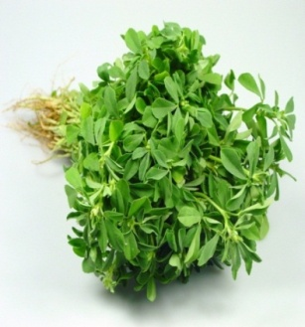

BASES
Substances which are bitter to taste are bases.
Gherkin
Bitter Gourd
Fenugreek

Slide 5



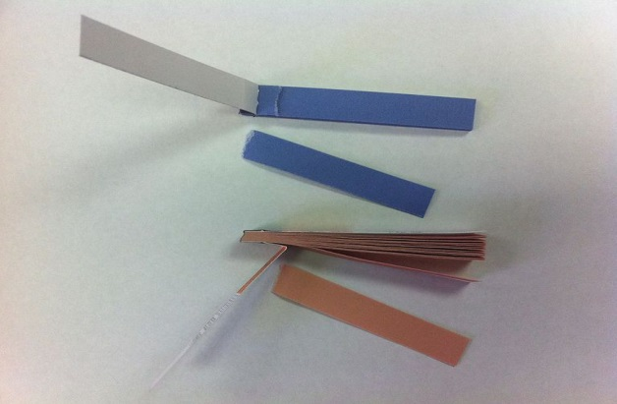

INDICATORS
COMMON E.g – Litmus paper
The acidic and basic nature of the compounds can also be indicated by some natural as well as chemical substances known as ……
As road rules are INDICATED by Traffic signal, similarly acids and bases are INDICATED by…
Each of three colours of the signal indicates the activity expected from the people, i.e. to stop, to be ready and to go.

Slide 6
ACIDS, BASES AND SALTS
Natural indicators

Slide 7
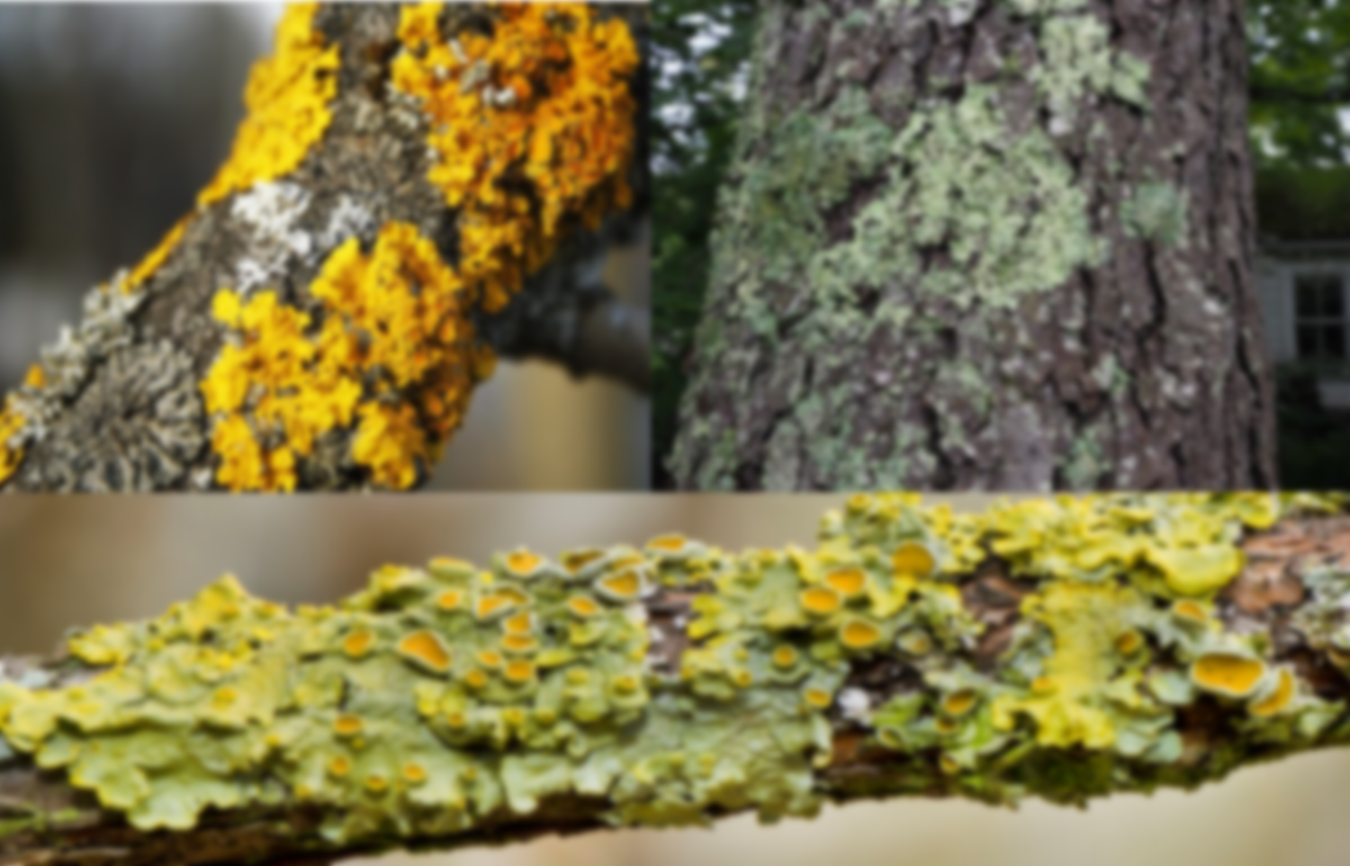
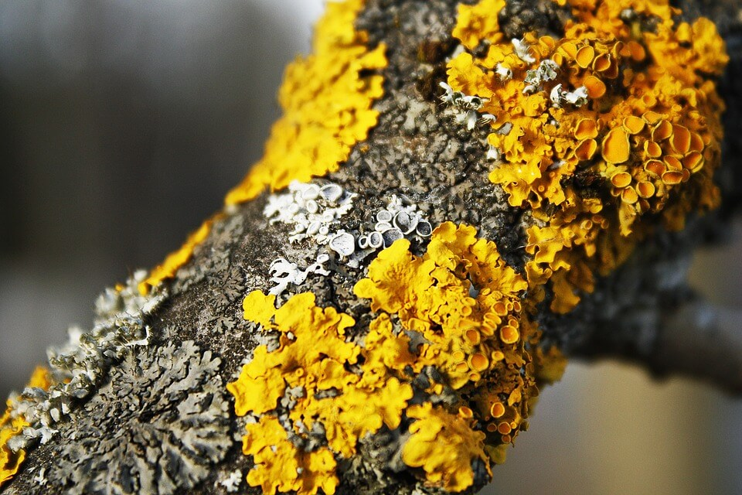
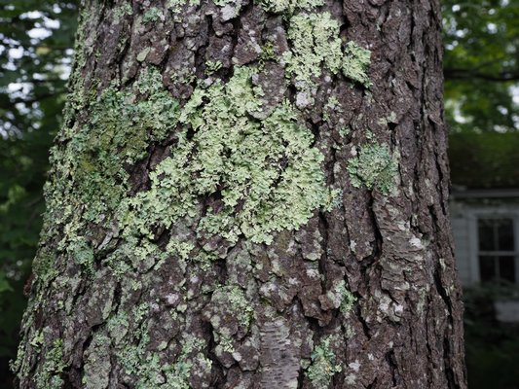
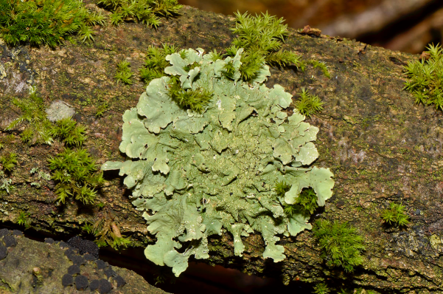
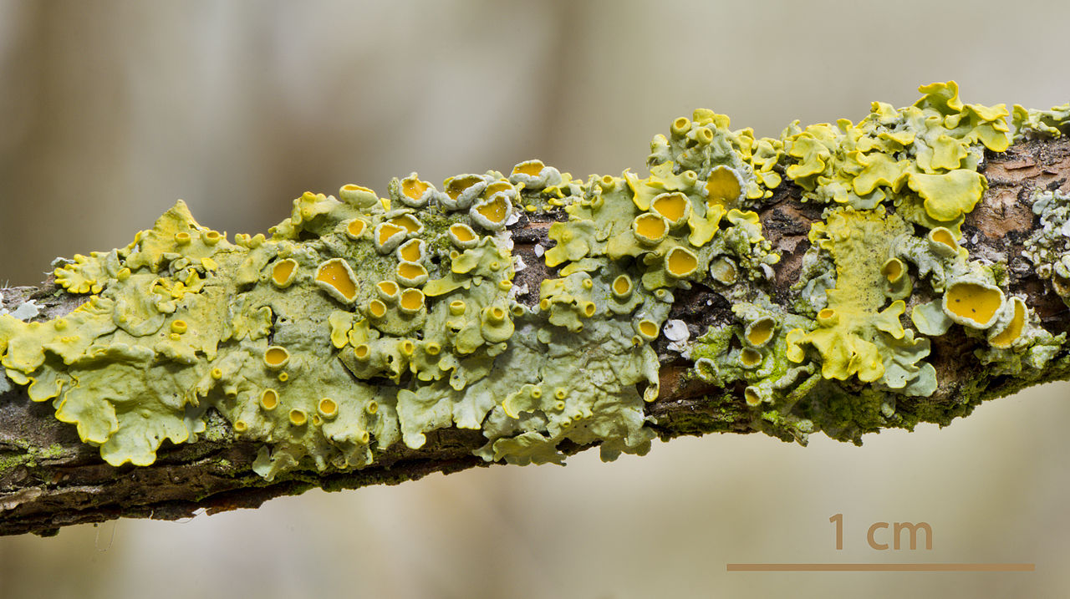
LITMUS
It is a natural indicator used to determine the nature of substance (acidic/basic).
Algae provides food and fungus provides shelter
Obtained from plants – LICHENS.
LICHENS - a plant belonging to the division Thallophyta
Colour of Litmus solution is PURPLE

Slide 8








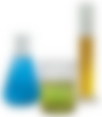

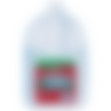

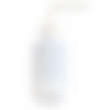

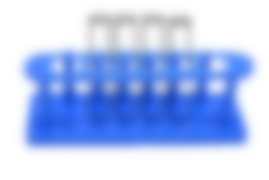










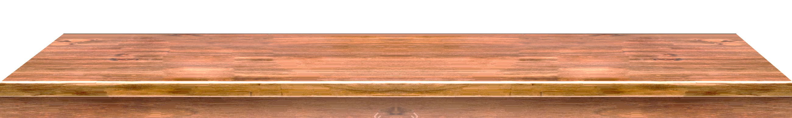
NATURAL
INDICATORS




Blue litmus paper turns red on dipping in acid and red litmus turns blue by alkali.
Acids change the colour of blue litmus to red
Red remains red and blue changes to red
Bases change the colour of red litmus to blue
Blue remains blue and red changes to blue
ACID
BASE

Slide 9
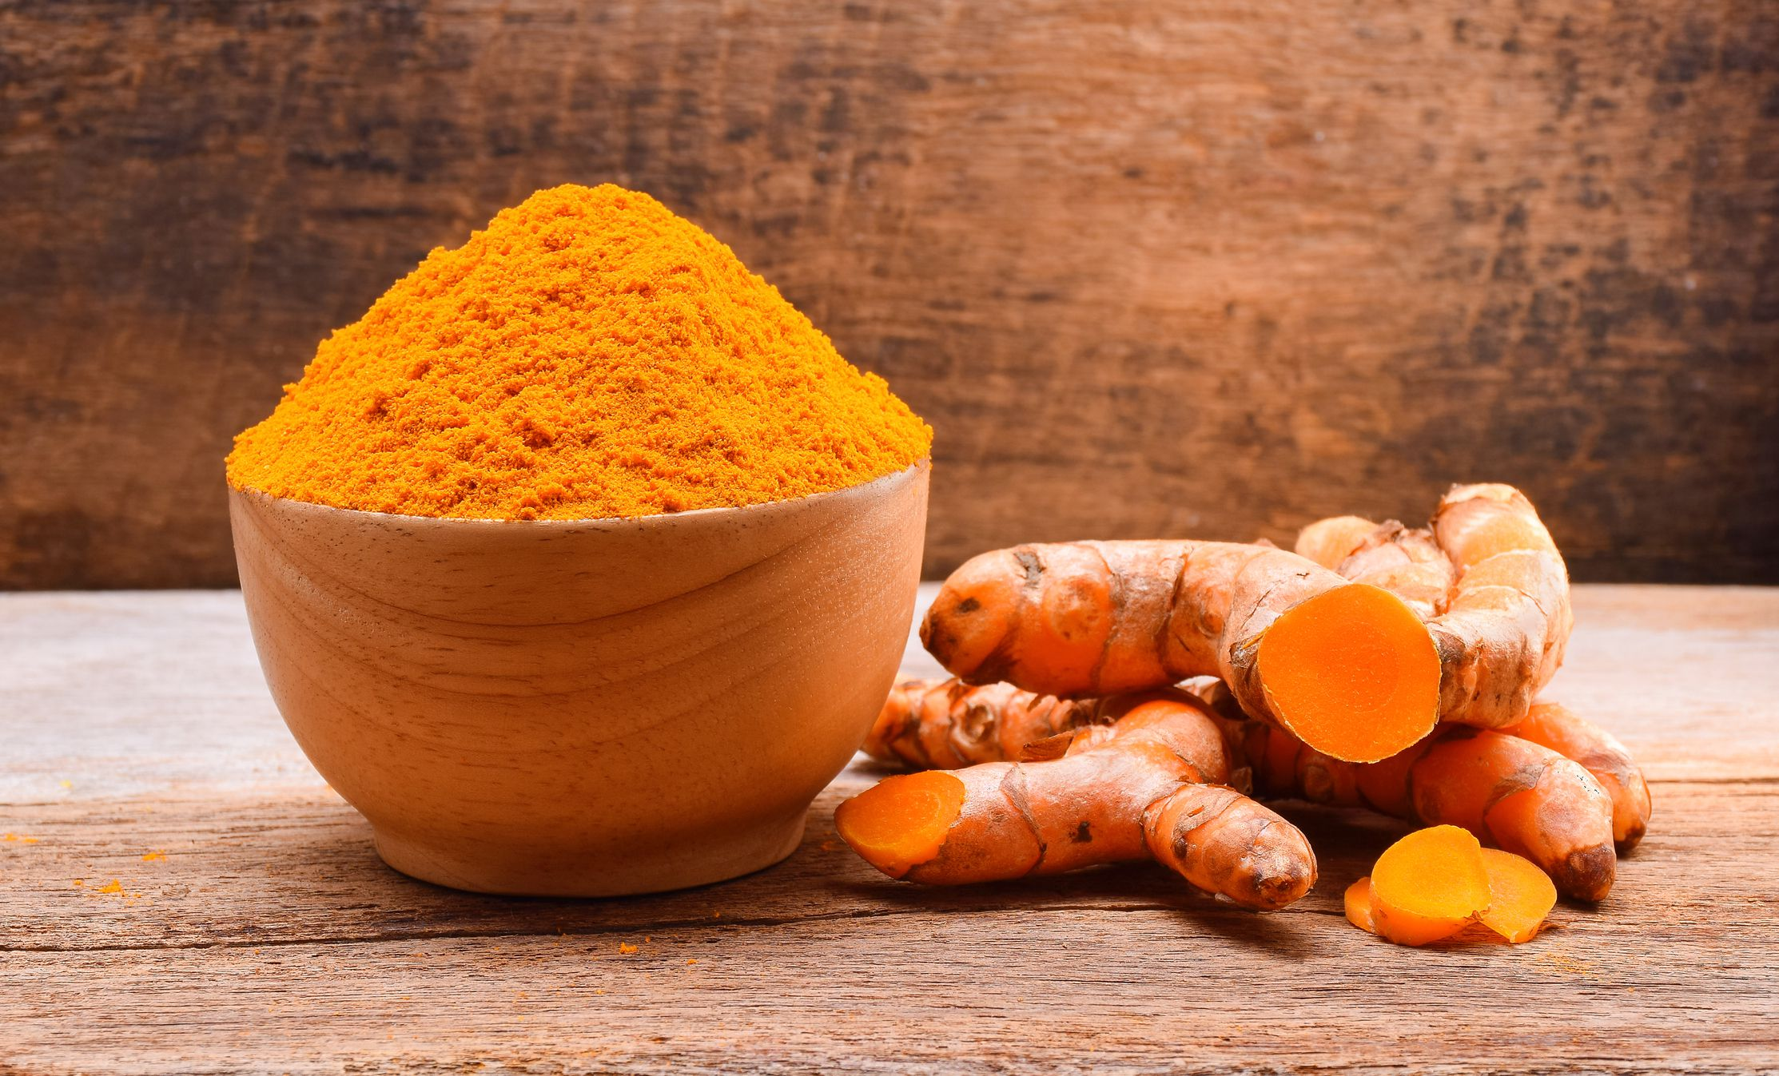
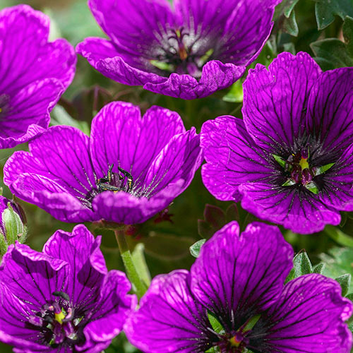
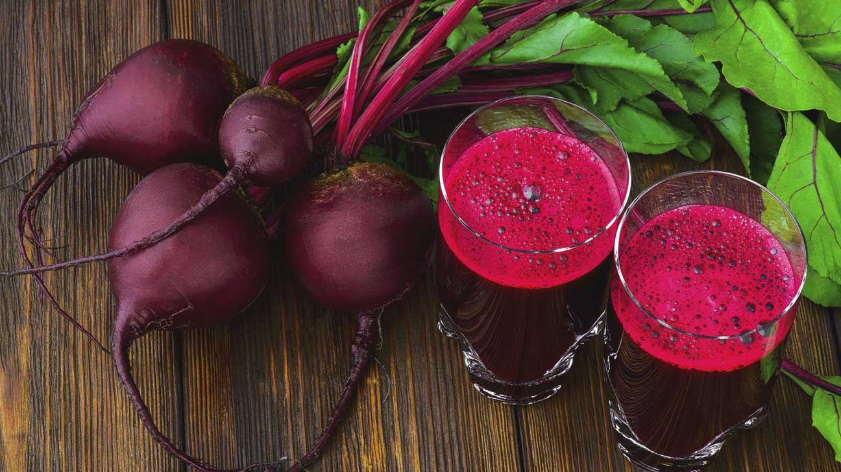
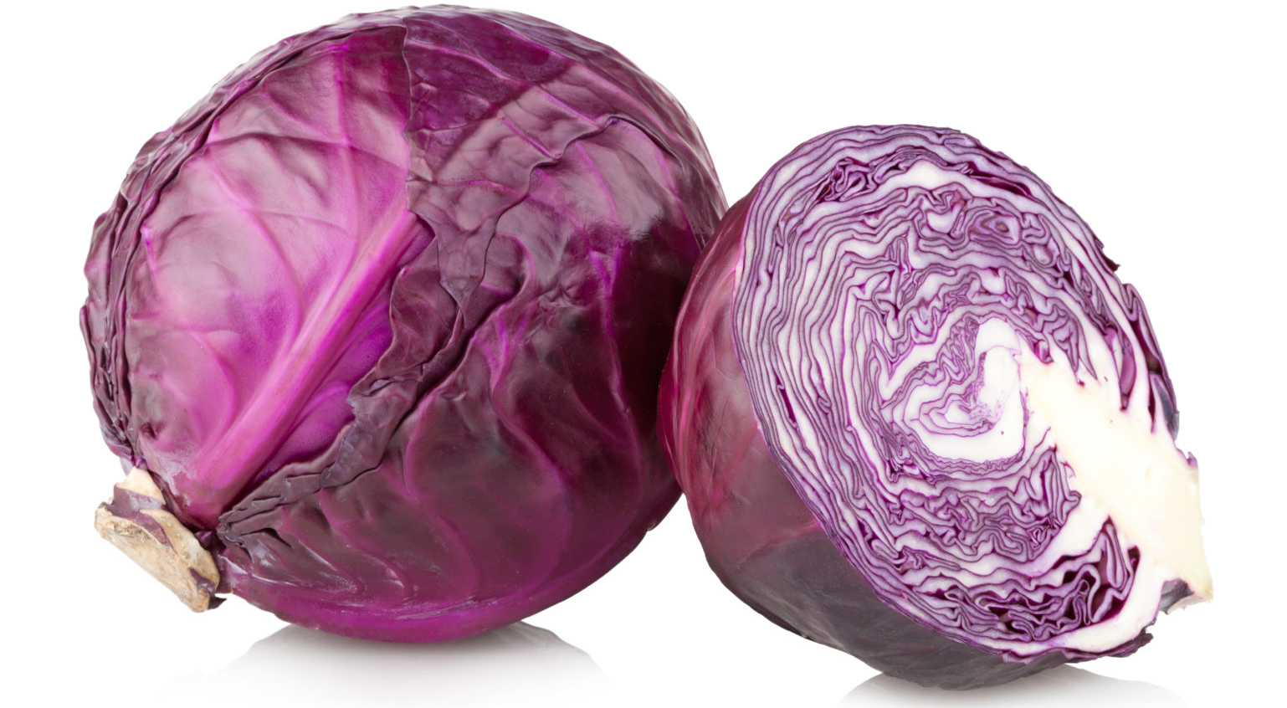
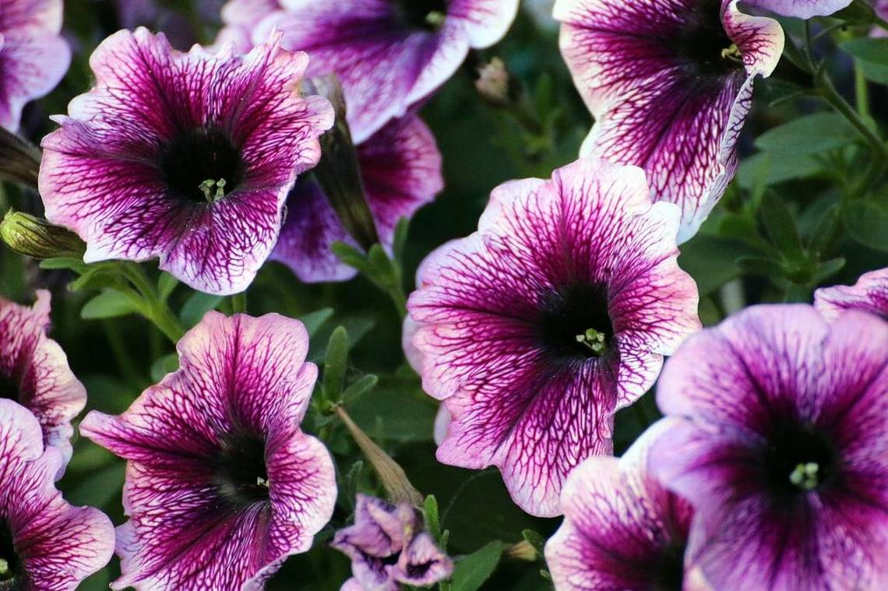

Natural substances
Natural indicators can also be prepared from
PETUNIA
TURMERIC
GERANIUM
BEET ROOT
RED CABBAGE EXTRACT

Slide 10
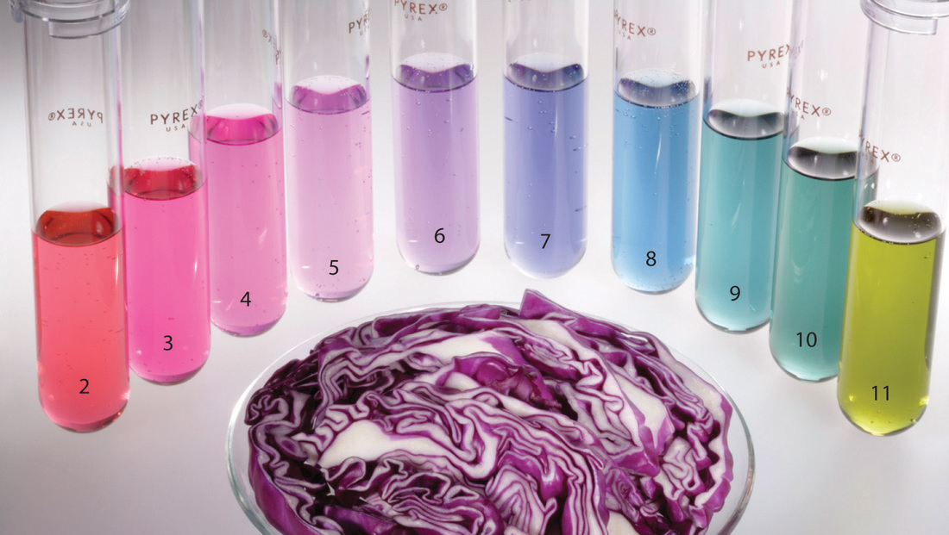
Red cabbage extract remains red in acidic solution but turns blue to green in basic solution.

Slide 11
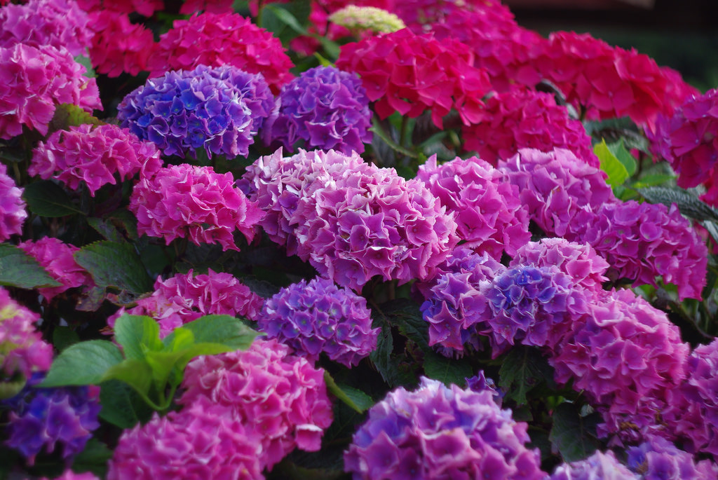

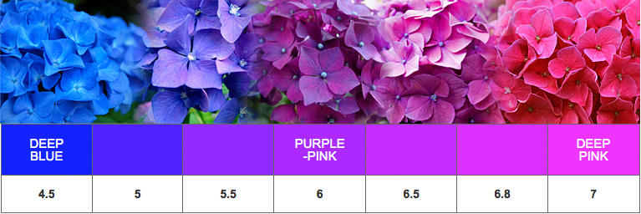
The flower of hydrangea plant are usually blue in acid which turn pink in the presence of base.

Slide 12
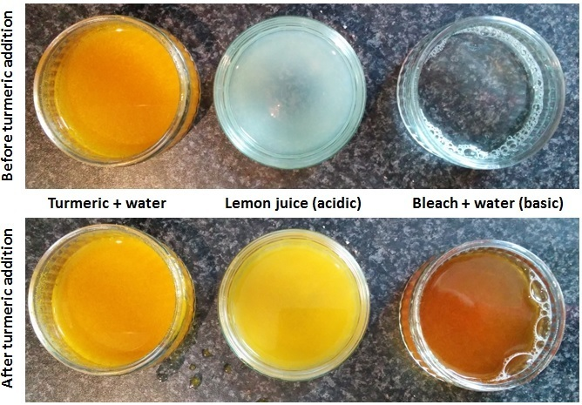
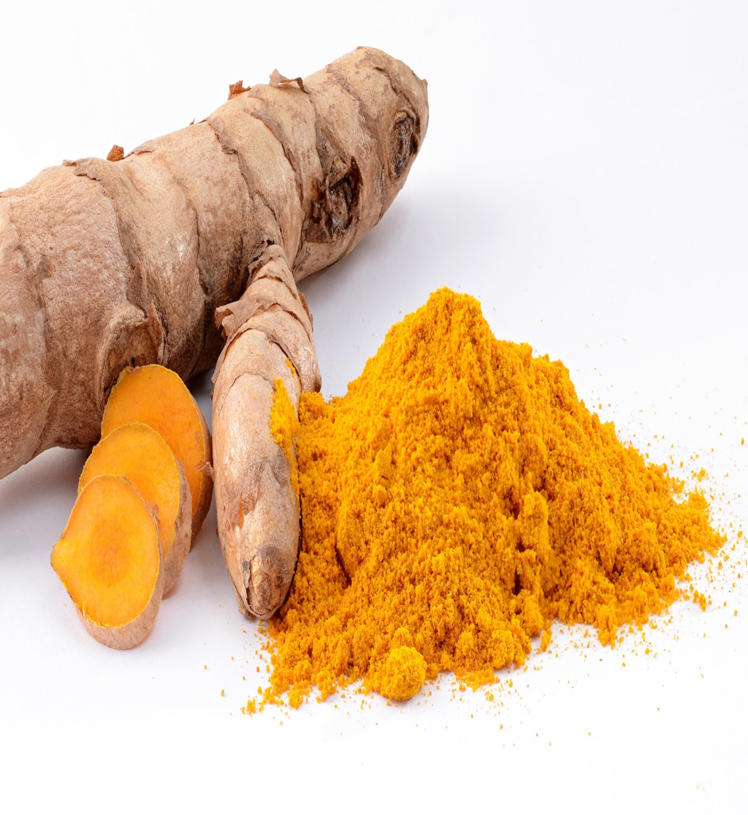
Many times we have noticed that yellow stain of curry on a white cloth (which is due to the presence of turmeric in curry) turns reddish-brown when soap is scrubbed on it. This is due to the fact that soap solution is basic in nature which changes the colour of turmeric in the curry stain to red brown.

Slide 13
ACIDS, BASES AND SALTS
Synthetic, olfactory and universal indicators

Slide 14

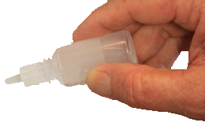
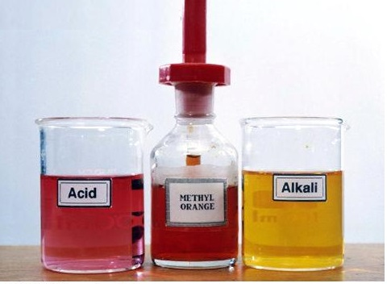
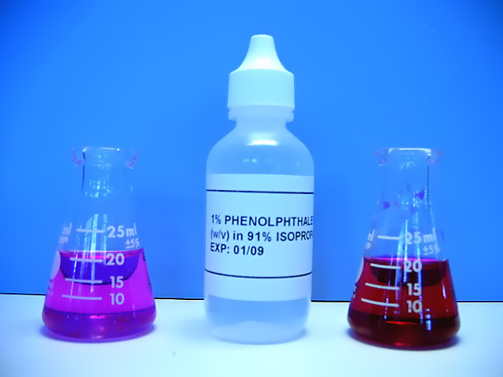


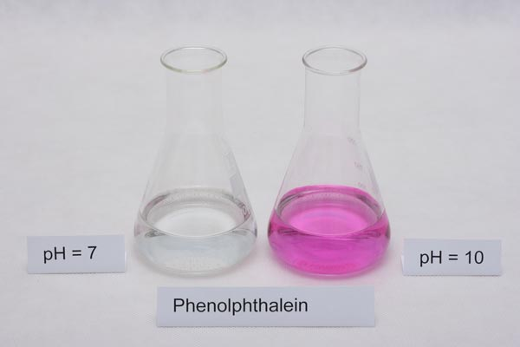
SYNTHETIC INDICATORS
Some chemical substances such as phenolphthalein, methyl orange, eosin are also indicators. They are synthetic indicators.
PHENOLPHTHALEIN
INDICATOR
No colour change
Colourless to pink
Phenolphthalein :
In acids - ________.
In bases - ________.
Add 2-3 drops of phenolphthalein
Indicator.
Artificially prepared
Take two unknown solutions in two different beakers.
And observe for any colour change.
Acid
Base
METHYL ORANGE
PHENOLPHTHALEIN

Slide 15
Sample solution
Red litmus solution
Blue litmus solution
Phenolph- thalein solution
Methyl orange
solution
HCl
No Change
Turns Blue
Colourless
Turns red
H₂SO₄
No Change
Turns Blue
Colourless
Turns red
HNO₃
No Change
Turns Blue
Colourless
Turns red
CH₃COOH
No Change
Turns Blue
Colourless
Turns orange
NaOH
Turns Blue
No Change
Turns pink
Turns yellow
Ca(OH)₂
Turns Blue
No Change
Turns pink
Turns yellow
KOH
Turns Blue
No Change
Turns pink
Turns yellow
Mg(OH)₂
Turns Blue
No Change
Turns pink
Turns yellow
NH₄OH
Turns Blue
No Change
Turns pink
Turns yellow

Slide 16

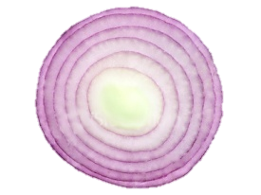
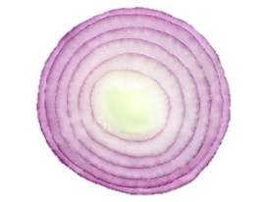

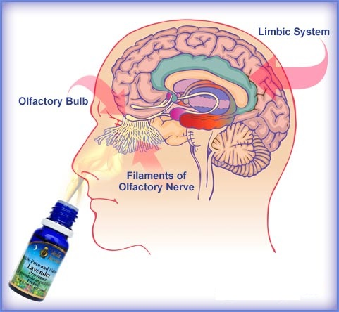

OLFACTORY INDICATORS
Onion slice
Since this indicator works on smell it is called as
Onion smell remains as it is
Onion smell goes off
Acid
Base
e.g:- onion
In acid smell of onion remains same but in base smell goes off
What a pungent smell onion has !!
In Acids :- odour remains as it is.
In Bases :- odour goes off.

Slide 17
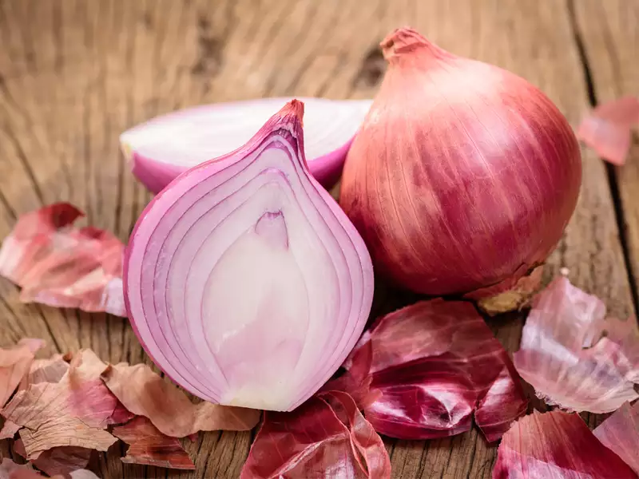
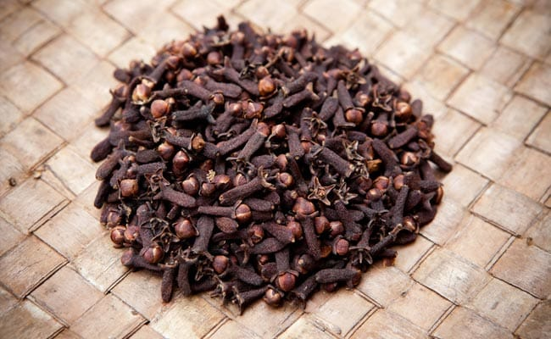
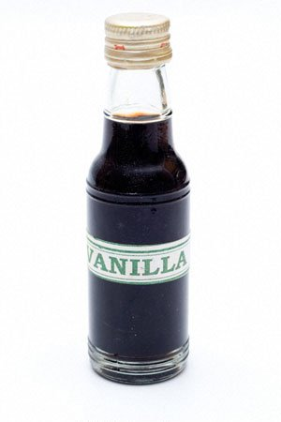
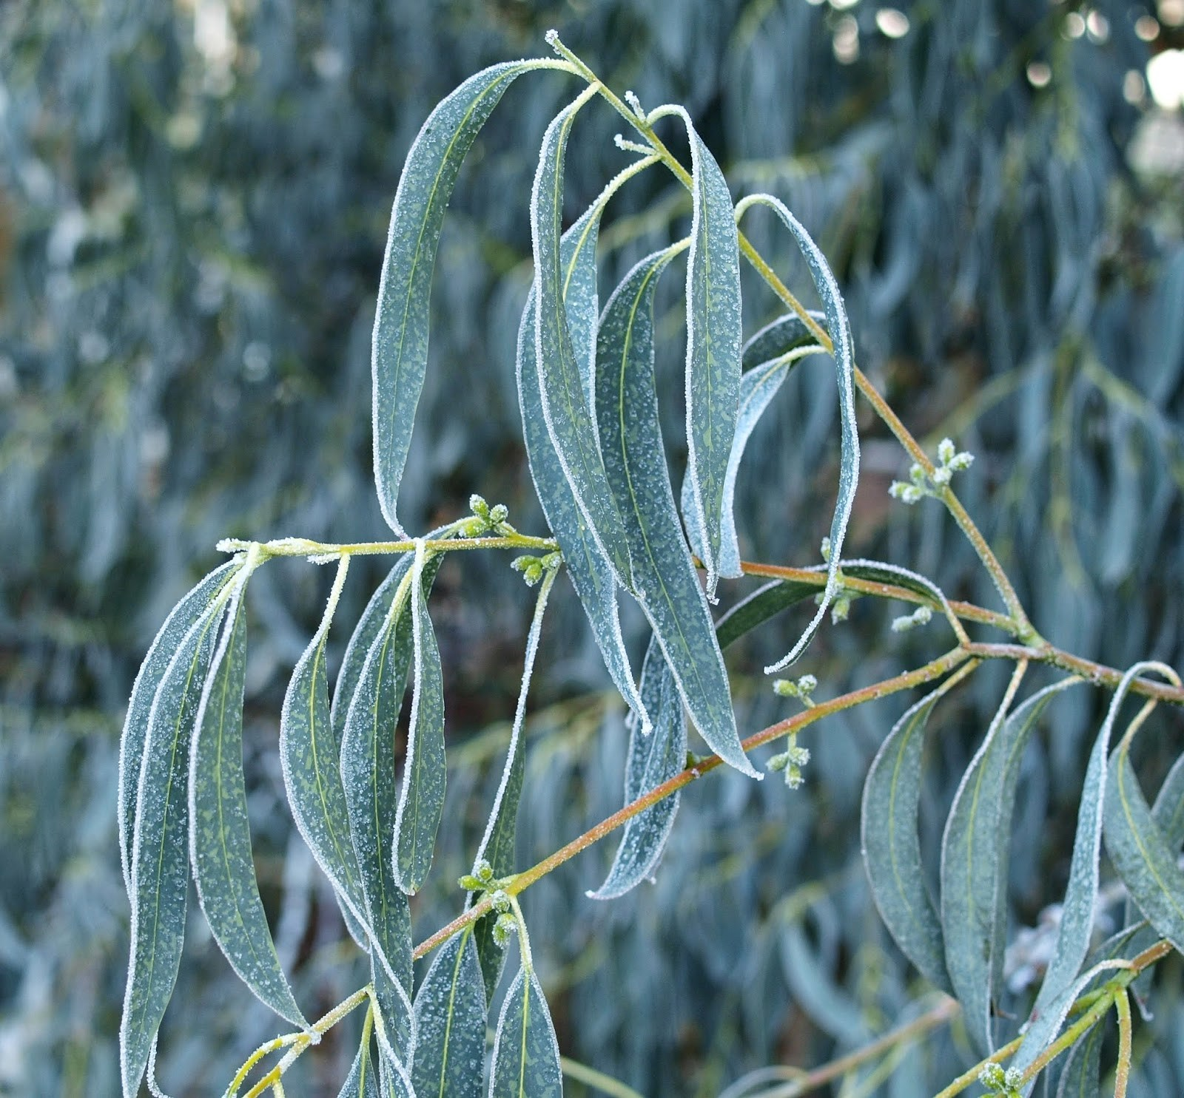
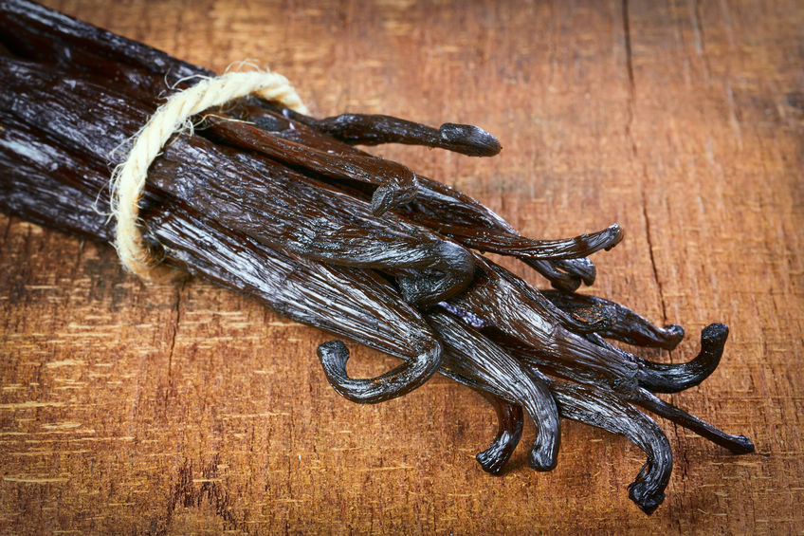
OLFACTORY INDICATORS.
Certain substances whose odour change in acidic or basic medium are known as
Onion
Clove
vanilla essence
Eucalyptus (nilgiri)
In Acids :- odour remains as it is.
In Bases :- odour goes off.

Slide 18
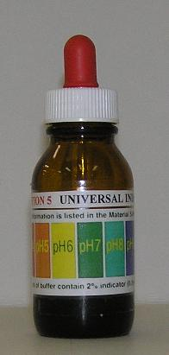
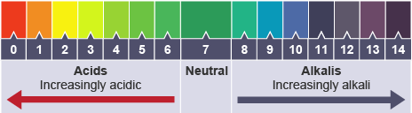
UNIVERSAL INDICATOR
Mixture of several indicators is known as UNIVERSAL INDICATOR.
Universal indicator not only tells us whether the given solution is acid or a base but we can also judge how strong an acid or base can be.

Slide 19
ACIDS, BASES AND SALTS
Chemical definition of acids
Mineral and organic acids

Slide 20

CHEMICAL DEFINITION OF ACID AND BASE
Acids
HCl_{(aq)}
H⁺_{(aq)} + Cl– _{(aq)}
H₂SO_{4(aq)}
₂
2H⁺_{(aq)} + SO₄^{2–}_{(aq)}
2
Splits into ions…
When dissolved in water…
Substances which when dissolved in water give
H⁺ ions are called as acids.
Valency of sulphate ion is 2
Bases
Mg(OH)_{2(s)}
Mg²⁺_{(aq)}+ 2 OH–_{(aq)}
KOH_{(aq)}
K⁺_{(aq)} + OH– _{(aq)}
Substances which when dissolved in water give
OH– ions are called as Bases.

Slide 21

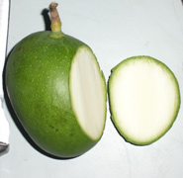
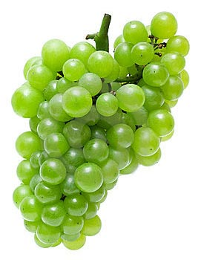



ORGANIC ACIDS
The acid present in plants and animals are called organic acids.
Some of the organic acids are citric acid, lactic acid, tartaric acid, oxalic acid etc.
Mango
Acids are classified into two types:
Organic acids
mineral acids
Tamarind
Orange
Grapes
Lemon

Slide 22





MINERAL ACIDS
The acid prepared form the minerals of the earth are called mineral acids.
Examples
Concentrated mineral acids are very dangerous. In laboratory acids are generally mixed with water to dilute them such acids are called dilute acids
Always add acid into water to avoid any accident.
Sulphuric acid (H₂SO₄)
Hydrochloric acid (HCl)
Nitric acid (HNO₃)

Slide 23
ACIDS, BASES AND SALTS
Classification of acids and bases :
Strong acids,
Weak acids,
Physical properties of acids

Slide 24

Classification of acids and bases depending on the number of H⁺ and OH– ions
STRONG ACIDS:-
Eg. HCl, HNO₃, H₂SO₄
The acids which give more number of HYDROGEN ions in aqueous solution are called STRONG ACIDS.
HCl_{(aq)}
H⁺_{(aq)} + Cl–_{(aq)}
WEAK ACIDS :-
Eg. CH₃COOH
All mineral acids are strong except carbonic acid
The acids which gives less number of
HYDROGEN IONS in aqueous solution are called WEAK ACIDS.
The dilute solution of weak acids are quite safe to drink
Hence they are use as food ingredients
All organic acids are weak acid
CH₃COOH_{(aq)}
H⁺_{(aq)} + CH₃COO–_{(aq)}

Slide 25

PROPERTIES OF ACIDS


Acids have a sour taste.
2. Acids turn blue litmus to red.
3. Acid solutions conduct electricity
(They are electrolytes).
4. Acids react with metals to form
hydrogen
Metal
+
Acid
Metal Salt
+
Hydrogen gas
Zn_{(s)}
+
H₂SO_{4(aq)}
ZnSO_{4(aq)}
+
H₂↑
Acid
Zinc
( A metal)
Sulphuric acid
(Dilute)
Zinc Sulphate
(A salt)
Hydrogen gas

Slide 26
ACIDS, BASES AND SALTS
Chemical properties of acid with metals

Slide 27





REACTION OF DILUTE SULPHURIC ACID WITH ZINC METAL
Glass delivery tube
Hydrogen gas burns with a ‘pop’ sound making a little explosion
Rubber cork
Stand
Burning candle
Boiling tube
Soap bubble filled with hydrogen
Dilute sulphuric acid
Trough
Zinc granules
Soap Solution

Slide 28
ACIDS, BASES AND SALTS
Chemical properties of acids

Slide 29
PROPERTIES OF ACIDS
Acids react with metal carbonates (and metal hydrogen - carbonates) to form carbon dioxide gas.
2
Na₂CO₃ + HCl
C
Na
C
O₃
2
O₂
NaCl + CO₂ + H₂O
Na
Sodium carbonate
Hydrochloric acid
Sodium chloride
Carbon dioxide
Water
NaHCO₃ + HCl
NaCl + CO₂ + H₂O
Sodium hydrogen carbonate
Hydrochloric acid
Sodium chloride
Carbon dioxide
Water
Metal carbonates
+
Acid
Salt
+
Carbon dioxide
+
Water
Metal hydrogen carbonates
+
Acid
Salt
+
Carbon dioxide
+
Water
The carbon dioxide gas is formed in the form of brisk effervescence
(the rapid escape of small bubbles of gas from the liquid)

Slide 30


PROPERTIES OF ACIDS
If excess of carbon dioxide gas is passed through lime water then the white precipitate formed first dissolves due to the formation of a soluble salt calcium hydrogencarbonate, and the solution becomes clear again.
Ca(OH)₂ + CO₂
CaCO₃ + H₂O
When carbon dioxide gas is passed through lime water, the lime water turns milky due to the formation a white precipitate of calcium carbonate
Calcium hydroxide
Carbon dioxide
Calcium
carbonate
(white precipitate)
CaCO₃ + CO₂ + H₂O
Ca(HCO₃)₂
Water
Calcium carbonate
Carbon dioxide
Water
Calcium hydrogen carbonate
(soluble in water)
Clear lime water
When carbon dioxide is passed through lime water, it turns milky
If carbon dioxide is passed for longer time, the milkiness disappear

Slide 31
ACIDS, BASES AND SALTS
Chemical properties of acids

Slide 32
PROPERTIES OF ACIDS
6. Acids react with bases (or alkalis) to form salt and water. It is known as neutralisation reaction.
Acid
+
Base
Salt
+
Water
NaOH + HCl
NaCl + H₂O
Sodium
hydroxide
Hydrochloric acid
Sodium chloride
Water
7. Acids react with metal oxide to form salt and water. Hence metallic oxides are said to be basic oxides
Metal oxide
+
Acid
Salt
+
Water
O
Cu
CuO + HCl
Cl
H
2
O
Cl₂
H₂
CuCl₂ + H₂O
Cu
Copper(II) oxide
Hydrochloric acid
Copper (II) chloride
Water

Slide 33







PROPERTIES OF ACIDS
Acids have corrosive nature.
The mineral acids cause severe burns on the skin and attack and eat up material like cloth, wood, metal structures and stone work, so they are said to be corrosive.

Slide 34

PROPERTIES OF ACIDS
Acids have a sour taste.
Acids turn blue litmus to red.
Acid solutions conduct electricity (They are electrolytes).
Acids react with metals to form hydrogen gas.
Acids react with metal carbonates (and metal hydrogen - carbonates) to form carbon dioxide gas.
Acids react with bases (or alkalis) to form salt and water.
Acids react with metal oxide to form salt and water.
Acids have corrosive nature.

Slide 35
ACIDS, BASES AND SALTS
Hydronium ion

Slide 36

What do all acids have in common
HCl
HCl
HCl
H⁺
H⁺
Cl⁻
Water
H⁺
Cl⁻
Cl⁻
HCl_{(aq)} H⁺_{(aq)} + Cl–_{(aq)}
This happens because H⁺ ions are not stable..
Separation of HCl into H⁺ and Cl⁻ ions will be possible in presence of water. The process is termed as ionization.
H⁺ + H₂O H₃O ⁺ (aq)
HYDRONIUM ION

Slide 37





To investigate whether all the compounds containing hydrogen are acids.
The aqueous solution of an acid conducts electricity due to the presence of charged particles called ions in it.
Bulb is glowing
Bulb does not glow
Bulb
Bulb
Battery
Battery
Switch
Beaker
Switch
Beaker
Nail
Nail
From this experiment we conclude that the hydrogen containing compounds such as glucose and alcohol are not acid because they do not dissociate in water to produce H⁺ ions.
Dilute HCI solution
Rubber cork
Rubber cork
Glucose Sol^{n}

Slide 38



Acids do not show acidic behavior in the absence of water
In absence of water, a substance will not form hydrogen ions and hence will not show its acidic behavior
CuCl_{2(s)} + H₂SO_{4(aq)}
CuSO_{4 (aq)}
2
+ HCl_{(g)}
Moist itmus paper
Dry litmus paper
Bent tube
one hold
stop cork
No Change
HCl gas
Take 0.5gm of copper chloride salt in a test tube. Add to it few drops of conc. H₂SO₄. Test the gas evolved with wet and dry litmus papers.
Hydrogen ions cannot exist alone. They will always combine with water and form hydronium
ion H₃O⁺
H⁺ + H₂O → H₃O₊
Separation of HCl into H+ and Cl– ions will be possible in presence of water. The process is termed as ionization.
Test – tube
Concentrated H₂SO₄
Copper chloride

Slide 39
ACIDS, BASES AND SALTS
Bases and properties of bases

Slide 40






BASES
Base which is soluble in water is also called an alkali.
Sodium hydroxide (NaOH)
Calcuim hydroxide [Ca(OH)₂]
Potassium hydroxide (KOH)
Ammonium hydroxide (NH₄OH)
Magnesium hydroxide [Mg(OH)₂]

Slide 41
Classification of acids and bases depending on the number of H⁺ and OH– ions
STRONG BASES:-
NaOH, KOH, NH₃.
The bases which give more number of HYDROXIDE IONS in aqueous solution are called STRONG BASES.
NaOH_{(aq)}
Na⁺_{(aq)} + OH–_{(aq)}
WEAK BASES:-
Eg. NH₄OH
The baseswhich gives less number of HYDROXIDE IONS in aqueous solution are called WEAK BASES.
NH₄OH_{(aq)}
NH₄⁺_{(aq)} + OH–_{(aq)}

Slide 42


PROPERTIES OF BASES


Bases have bitter taste.
2. Bases feel soapy to touch.
Bases turns red litmus blue.
BASE

Slide 43

PROPERTIES OF BASES
4. Base conduct in solution electricity
(They are electrolytes).
5. Bases react with some metals to form hydrogen gas (only Al and Zn)
NaOH_{(aq)}
+
Zn_{(s)}
Na₂ZnO_{2(aq)}
+
H_{2(g)}
2
Sodium hydroxide
(base)
Zinc
(metal)
Sodium zincate (salt)
Hydrogen gas

Slide 44
ACIDS, BASES AND SALTS
Chemical properties and uses of bases

Slide 45
PROPERTIES OF BASES
Bases react with acids to form salt and water
NaOH_{(aq)}
+
H₂SO_{4(aq)}
Na₂SO_{4(aq)}
+
H₂O_{(l)}
2
2
Sodium hydroxide(base)
Sulphuric acid
Sodium sulphate(salt)
Water
Bases react with non-metal oxides to form salt and water. Hence, non-metallic oxides are acidic in nature.
Ca(OH)_{2(aq)}
+
CO_{2(g)}
CaCO_{3(s)}
+
H₂O_{(l)}
Calcium hydroxide(base)
Carbon dioxide
(non-metal oxide)
Calcium carbonate(salt)
Water

Slide 46
ACIDS, BASES AND SALTS
Introduction of pH scale

Slide 47

STRENGTH OF ACIDS AND BASES
Strength of acids and bases is measured by a pH scale.
In pH, p stands for potenz (strength in German)

Slide 48



Universal indicator with different pH values
0
1
2
3
4
5
6
7
8
9
10
11
12
13
14





Gastric juice
pH = 1
Sodium hydroxide
pH = 14

Lemon juice
pH = 2

Pure water
pH = 7

Milk of magnesia
pH = 10


Gastric juice
Lemon juice
Pure
water
Milk of magnesia
Sodium hydroxide

Slide 49
Sr.
No.
Solution
Colour of pH paper
Approximate pH value
Nature of substance
1.
Saliva (before meal)
Green
7.4
Basic
2.
Saliva (after meal)
Yellow
5.8
Acidic
3.
Lemon juice
Orange
2.5
Acidic
4.
Colourless aerated drink
Green
6
Acidic
5.
Carrot juice
Yellow
5.6
Acidic
6.
Coffee
Yellow
5
Acidic
7.
Tomato juice
Orange
4.1
Acidic
8.
Tap water
Green
6.9
Acidic
9.
1M NaOH
Blue
13
Basic
10.
1M HCl
Red
1
Acidic

Slide 50
ACIDS, BASES AND SALTS
Importance of pH in everyday life

Slide 51




IMPORTANCE OF pH IN EVERYDAY LIFE
Acid rain
pH range of human body is 7.0 to 7.8 .
When the pH of rain water is less than 5.6, the rain water is acidic. When it flows in a river, it lowers the pH of river water.
Aquatic life is drastically affected due to acidic nature. Not only that, when this type of rain water is absorbed by plants, it affects their growth, the flowers and fruits they bear.

Slide 52




Importance of pH in Tooth decay
Tooth decay starts when pH of mouth is lower than 5.5
Tooth enamel is made up of calcium hydroxyapatite
(a crystalline form of calcium phosphate)
Bacteria present in the mouth produce acids by degradation of sugar and food particles remaining in the mouth after eating.
Using toothpastes, which are generally basic, for cleaning the teeth can neutralise the excess acid and prevent tooth decay.

Slide 53





STOMACH ACIDITY
The human body : pH 7.35 to 7.45
Hydrochloric acid produced in the stomach helps in digestion of food. Due to too much production of acid, causes pain and irritation
The acidity, indigestion problems can be controlled by adding basic substances called ANTACIDS.
Example : Magnesium hydroxide (Milk of
Magnesia)
Basic substances that neutralizes acid in the stomach.

Slide 54





SOIL pH IN THE BACKYARD
Most of the plants grow best when the pH of soil is close to 7. If the soil is too acidic or too basic (too alkaline), the plants grow badly or do not grow at all.
If the soil is acidic then it is treated with materials like quicklime (CaO)
Before
After

Slide 55
ACIDS, BASES AND SALTS
Self defence by animals and plants

Slide 56






SELF DEFENCE BY ANIMALS AND PLANTS THROUGH CHEMICAL WARFARE
When a honey–bee sting a person, it injects an acidic liquid (Methanoic acid) to the skin.
acidic
When a wasp stings it injects an alkaline liquid into the skin.
alkaline
Also called formic acid
An ants sting injects methanoic acid into the skin of a person causing burning pain
methanoic acid
Many animals and plants protect themselves from their enemies by injecting painful and irritating acids and bases into their skin.
Stinging hair of nettle leaves inject methanoic acid causing burning pain.
base
Then the rubbing a mild base like baking soda on the stung area of the skin give relief
A traditional remedy is rubbing the area with the leaf of the
dock plant, which often grows beside the nettle in the wild.
dock plant
A traditional remedy is rubbing the area with the leaf of the
dock plant, which often grows beside the nettle in the wild.
dock plant

Slide 57


SALT
Types of salts:
Acidic,
Basic
and Neutral salts
An acidic salt is formed by the neutralization reaction between a strong acid and a weak base. The pH of the aqueous solution of an acidic salt is less than 7.
A basic salt is formed by a neutralization reaction between a weak acid and a strong base. The pH of an aqueous solution of such a basic salt is greater than 7.
A neutral salt is formed by neutralization of a strong acid by a strong base. The aqueous solution of a neutral salt has pH equal to 7.

Slide 58

ROCK SALT
Deposits of solid salt are also found in several parts of the world. These large crystals are often brown due to impurities. This is called rock salt.

Slide 59
CHLOR-ALKALI PROCESS
2NaCl_{(aq)}
+
2H₂O_{(l)}
2NaOH_{(aq)}
+
Cl₂(g) + H₂(g)
Cl₂
+
–
H₂
(Water treatment, swimming pools, PVC, disinfectants, CFCs pesticides)
(Fuels, margarine, ammonia for fertilisers)
Brine containing
Brine
Cl–
NaOH
OH–
Na–
(De-greasing metals, soaps and detergents, paper making, artificial fiber)
H⁺
Membrane

Slide 60
ACIDS, BASES AND SALTS
Bleaching Powder and it’s uses
Baking soda and it’s uses

Slide 61



BLEACHING POWDER
Chlorine is produced during the electrolysis of aqueous sodium chloride (brine).
This chlorine gas is used for the manufacture of bleaching powder.
Bleaching powder is produced by the action of chlorine on dry slaked lime [Ca(OH)₂].
Ca(OH)₂ + Cl₂
CaOCl₂ + H₂O

Slide 62





BLEACHING POWDER
Bleaching powder is used –
for bleaching cotton and linen in the textile industry, for bleaching wood pulp in paper factories and for bleaching washed clothes in laundry;
i
as an oxidising agent in many chemical industries; and
ii
iii
to make drinking water free from germs.

Slide 63






BAKING SODA
The baking soda is commonly used in the kitchen for making tasty crispy pakoras, etc. Sometimes it is added for faster cooking.
The chemical name of the compound is sodium hydrogen carbonate (NaHCO₃). It is produced using sodium chloride as one of the raw materials.
NaCl + H₂O + CO₂ + NH₃
NH₄Cl + NaHCO₃
On heating baking soda we get washing soda
2
Heat
NaHCO₃
Na₂CO₃ + H₂O + CO₂

Slide 64
ACIDS, BASES AND SALTS
Washing soda and it’s uses
Water of Crystallisation
Plaster of Paris and it’s uses

Slide 65


WASHING SODA
Chemical formula :
Na₂CO₃. 10H₂O.
Chemical name :
Sodium carbonate
Heat
NaHCO₃
Na₂CO₃ + H₂O + CO₂
2
Na₂CO₃ + 10H₂O
Na₂CO₃. 10H₂O

Slide 66






USES OF WASHING SODA
glass,
Sodium carbonate (washing soda) is used in
Soap
and paper industries.
It is used in the manufacture of sodium compounds
such as borax.
Sodium carbonate can be used as a cleaning
agent for domestic purposes.
It is used for removing permanent hardness of
water.

Slide 67


WATER OF CRYSTALLISATION
Water of crystallisation is the fixed number of water molecules present in one formula unit of a salt.
Example:
5H₂O
Copper sulphate : CuSO₄. 5H₂O
2H₂O
Gypsum : CaSO₄. 2H₂O

Slide 68




WATER OF CRYSTALLISATION
Water droplets
Copper sulphate cystals
Boiling Tube
If your moisten the crystals again with water , you will find that blue colour of the crystal reapears.
We heat the crystals, this water is removed and the salt turn white
Burner

Slide 69

PLASTER OF PARIS
On heating gypsum at 373 K, it loses water molecules and becomes calcium sulphate hemihydrate (CaSO₄.
H₂O).
1
2
Plaster of Paris is a white powder and on mixing with water, it changes to gypsum once again giving a hard solid mass.
CaSO₄.2H₂O + Heat
2
CaSO₄.
2
3
H₂O
H₂O
+ H₂O
1/2
Gypsum
Plaster of Paris
Water
Basically 2CaSO₄ molecules are sharing 1H₂O molecule hence CaSO₄.1/2 H₂O.
1
1
CaSO₄ H₂O + 1 H₂O
CaSO₄.2H₂O
2
2
(Plaster of Paris)
(Gypsum)

Slide 70




USES OF PLASTER OF PARIS
It is use as plaster for supporting fractured bones in the right position.
It is used for making toys.
It is use as materials for decoration
It is use for making surfaces smooth.

Slide 71
Thank You

